Slide 1
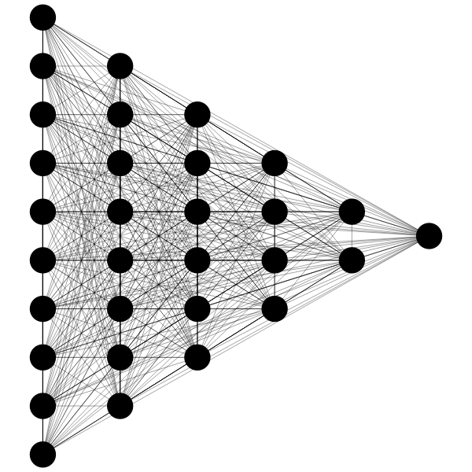

AI SATURDAY LAGOS
COHORT 5
Facial Expression Recognition

Slide 2
Outline
Introduction
Deep Learning & CNNs
Background of Study
Problem Statement & Objectives
Procedures & Results
Procedures
Results
Summary and Conclusion
Summary
Conclusion

Slide 3
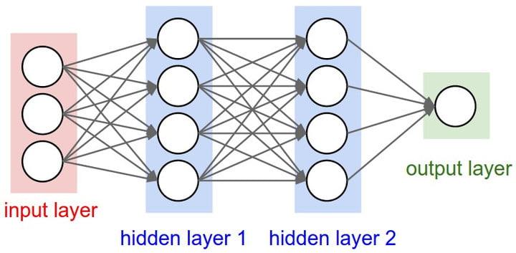
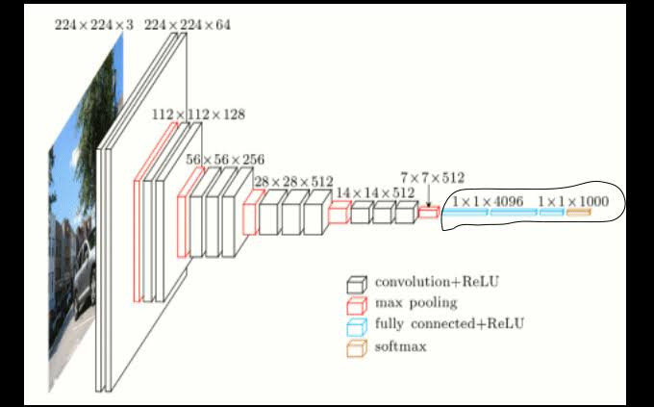
Introduction
Deep Learning - Neural Networks
Artificial Neural Networks are brain-inspired systems which are intended to replicate the way we humans learn.
Neural networks consist of input and output layers, as well as (in most cases) a hidden layer consisting of units that transform the input into something that the output layer can use.
Convolution Neural Network
A ConvNet is in its simplest case a list of Layers that transform the image volume into an output with some differentiable function that may or may not have parameters.
CNNs do take an image, pass it through a series of convolutional, nonlinear, pooling (downsampling), and fully connected layers, and get an output of either a single class or a probability of classes that best describes the image.

Slide 4
Applications of Deep Learning

Slide 5
Background of Study
Facial expressions communicate better than words.
In recent years, the technique of facial expression recognition has been vastly explored
and this has solved a huge problem in many areas of application. Such as the business places for customer relationship evaluation, on a Police patrol or during investigations, in a psychology session and many more.
Emotion recognition is very important as facial expressions can easily go unnoticed due to
busy schedules or mere neglect. That is why researchers in this area are concerned about
building systems that can assist humans to pick on different faces so as to improve good
relationships with customers, clients and even colleagues.

Slide 6
Problem Statement & Objectives
Problem Statement:
A certain retail company desperately wants to retain existing customers than acquire new ones via advertising and other methods. After performing analysis on existing customers, the data analyst team reported that poor customer service is often the root of losing loyal customers. Your company (an AI consulting firm) proposes to build a facial recognition system capable of predicting the state/emotion of customers, so as to notify employees around the store to immediately assist the customers with questions and concerns about a product.
Objectives:
Select three classes (Sad, Happy, Neutral) for Classification.
Source a reliable dataset and perform data processing procedures.
Buid a model and achieve a high accuracy.

Slide 7
Procedures and Results
Procedures
Frameworks:
Fast.ai
PyTorch
Tensor Flow
Other Tools Used:
Jupyter Notebook
Google Suites(Drive, Chrome, Google Colaboratory)
Technical Aids (Sources: Facilitator & Websites) etc.

Slide 8
Procedures
Procedural Processes Includes:
Sourced Datasets: image and. csv format (Kaggle) Fer2013 Dataset.
Data Cleaning (Manual): Extracted wrong images (invalid files, irrelevant images), re-categories misclassified images, sorted out three classes of facial expressions.
Notebook Procedures:
Data Processing
Model Building
Model Training
Model Accuracy Visualization
Model Test Training
Test Visualization

Slide 9
Results
Fast.ai
Pytorch
TensorFlow
Validation Accuracy: 76%
Validation Accuracy: 98%
Test Accuracy: 76%
Validation Accuracy:
Test Accuracy:

Slide 10
Fastai
A library built on PyTorch to train models faster and easier.
During the training, the models used were:
Resnet18
Se_resnet50_32x4d
Se_resnet50
VGG19_bn
Out of them, vgg19_bn, gave the best predictions with a valid accuracy of 76%
under 20 epochs and an error rate of 0.24.

Slide 11
Summary & Conclusion
Summary
Dataset: The Fer2013 contained approx. 34,000+ images combined before extracting the 3 categories.
Total:
Training images approx. 15,000 images.
Test Images approx. 3,000 images.
Best Model Details: FrameWork = fastai Pretrained Model: se_resnext50_32x4d
Optimizer: Adam (lr=le-4)
Scheduler: ReduceLROnPlateau (mode="min", patience=5, factor=0.3, verbose=True)

Slide 12
Conclusion
AI can help firms predict what customers feel, using AI should lead to substantial improvements in
productive outcomes.
After the research that was put into this project, we could speak of the relevance this will have in
reaching the goal of the retail company. If expressions are often recognized, the firms can be able to retain their existing customers by warmly meeting to each of their needs.
Therefore, these models can be applicable to real cases if deployed.
Limitation: Understanding context in which customer's facial emotional expressions is made is important. For example, a person could be frowning their brow not because they are sad or angry but because they are concentrating or the sun is shining brightly and they are trying to shield their eyes.

Slide 13
Thank you!

